Slide 1
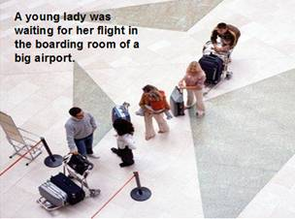
Click to advance the show

Slide 2
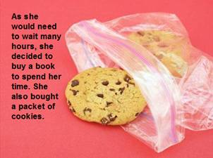

Slide 3
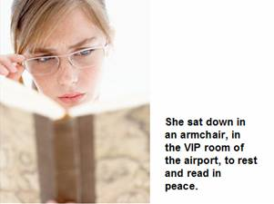

Slide 4
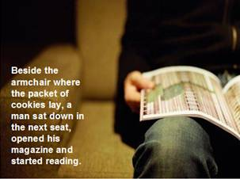

Slide 5
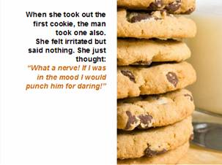

Slide 6
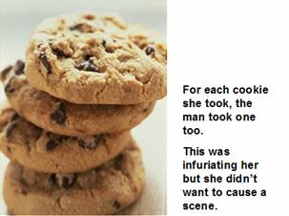

Slide 7
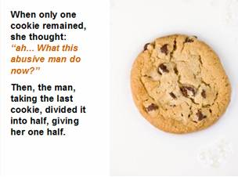

Slide 8
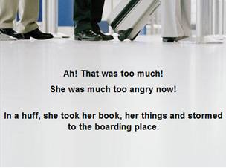

Slide 9
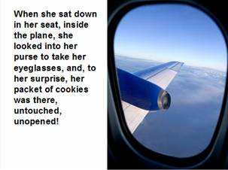

Slide 10
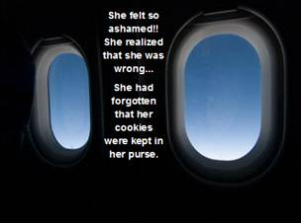

Slide 11
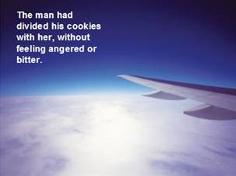

Slide 12
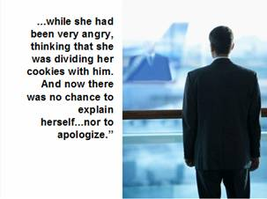

Slide 13
The moral of the story…

Slide 14
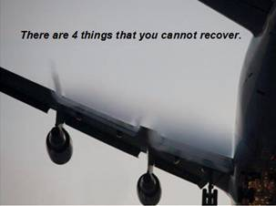

Slide 15
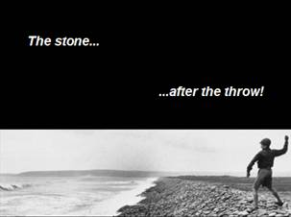

Slide 16
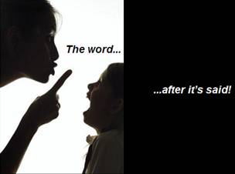

Slide 17


Slide 18
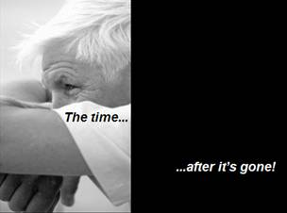

Slide 19

Hello there nice person;
Did anyone ever tell you just how special you are?
The light that you emit might even light a star.

Slide 20

Did anyone ever tell you how important you make others feel.
Somebody out there is smiling. about love that is so real.

Slide 21

Did anyone ever tell you that many times when they were sad your e-mail made them smile a bit, in fact it made them glad.

Slide 22
For the time you spend sending things and sharing whatever you find, there are no words to thank you, but somebody thinks you're fine.
Did anyone ever tell you just how much they like you? Well, my dearest friend today I am telling you.

Slide 23

I believe that without a friend you are missing out on a lot!!!
Have a nice day, and I'm glad we are friends!!!

Slide 24


